Slide 1
Automatic Structure Determination Using 2D NMR Spectra

Slide 2
Aim of Project
Fully ( or partially) determine the chemical structure of a molecule sample using NMR information
NMR Types used to Determine Structure:
COSY
HSQC
HMBC
NOESY

Slide 3
Aim of Project
The project aims to develop the structure solver such that it requires as little 'expert knowledge' as possible, and is guided by a small set of fundamental rules, rather than a large knowledge base experimentally collected information.

Slide 4
Development of Project
Program developed iteratively
Three distinct versions of the program using different methods of determining the structure, with the third (most recent) version the most effective
Two parts of the program:
Processing NMR Data
Structure Determination and energy minimisation

Slide 5
NMR Processing
All three iterations of the program use the same method of processing NMR Data
Initially, Human intervention is required in order to generate the NMR data to input into the program

Slide 6
NMR Processing : 1D Data
Using MestReNova, select integration regions for the 1D Carbon and 1D Hydrogen spectra:
Note: The 1D Carbon Integral value is ignored, only the shift of the peak is used. This was only for convenience within the code and may change
For 1H the integral value is used to determine the number of protons in that peak

Slide 7
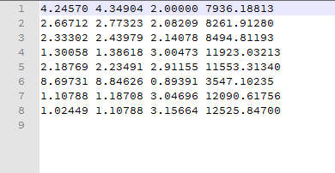
NMR Processing : 1D Data
Example of 1D Hydrogen Peak Data File
Minimum and Maximum shifts around peak
Normalised Integration Value
Absolute Integration Value (ignored)

Slide 8
NMR Processing : 2D Data
Using MestReNova, for each of the COSY, HSQC, HMBC spectra:
Select 2D peaks manually and check that their shift values correspond to a pair of 1D peaks (there is error-checking involved later, but some issues can evade this)
Export this 2D Peak Data

Slide 9
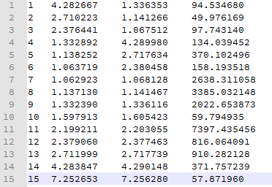
NMR Processing : 2D Data
Example of COSY H-H Peak Data File
Peak
Number
Peak Value 2
Intensity
(ignored)
Peak Value 1

Slide 10
NMR Processing
1D Signal Generator reads in all the 1D peak values first, and sets the shift value to be the mean of the lower and upper bound of the integration region and generates a list of 1D Signals
2D Signal Generator then reads in all 2D peak values.

Slide 11
NMR Processing
Each shift coordinate on the 2D peak is compared with the shift coordinates of 1D Signal peaks.
If the coordinates vary by less than a small error value from one peak in each dimension then the 2D peak is considered to be a cross peak between those two signals.
If the coordinates vary by more than a small value from all peaks, then it is discarded
For COSY peaks, asymmetric peaks are removed

Slide 12
NMR Processing
Once all peaks have been read into the program, a matrix of interactions is created, corresponding to the 2D peaks representing interactions between 1D peaks.
Additionally, another interaction type can be inferred from COSY and HSQC in the way shown below:
COSY
H
H
HSQC
C
C
Inferred INADEQUATE Bond

Slide 13
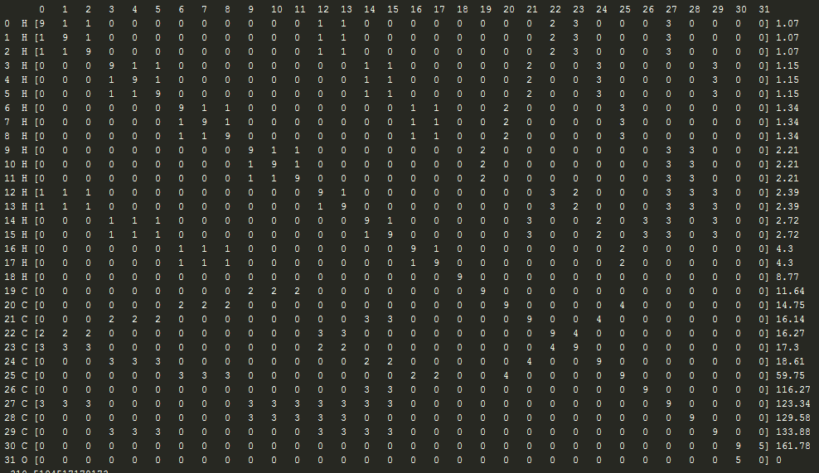
Interaction Matrix Example

Slide 14
Structure Solver: Version 1
The first version of the structure solver attempted to find the structure by modelling the system as a global energy minimisation problem.
For each of the interaction types currently used (COSY, HMBC, HSQC, INAD) a function is generated of the form:
Such that # is adjusted such that the minimum of the function is set at the correct distance between the corresponding atoms.

Slide 15
Structure Solver: Version 1
The global energy function is the sum of the pairwise interactions between all atoms, and therefore the global minimum is reached when the distances between corresponding atoms is such that each of the 1D minimums is reached.
Any atoms with no interaction between them have a 'Default' energy function that is high energy (effectively repulsive) at short distances since non-interacting values should not be within bonding distance

Slide 16
Structure Solver: Version 1
HMBC interactions were more difficult to handle, since they can represent either 2 or 3 bond interactions, so the interaction function cannot have a strictly defined single minimum.

Slide 17
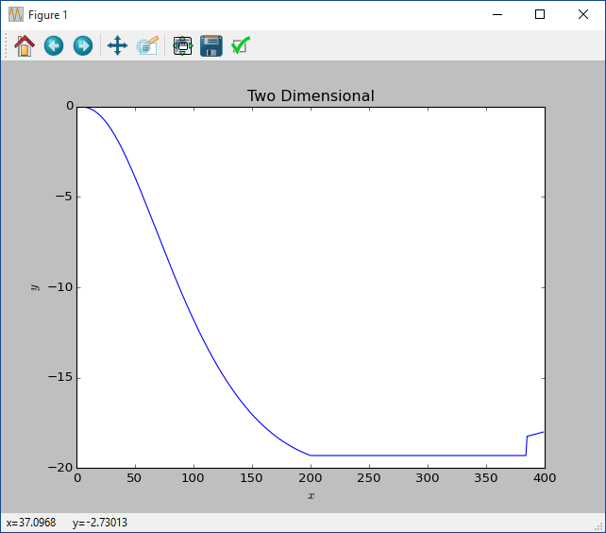
Structure Solver: Version 1
Since the optimal distance for HMBC could take a range of values, a flat-bottomed function was created, with a range of minimum values as shown here:

Slide 18
Structure Solver: Version 1
Energy optimisation process:
The coordinates of all of the atoms begins at the origin.
A Basin Hopping algorithm is used to randomly alter the coordinates of the atoms in the system, and an initial temperature function assists in overcoming local minima.
The atom coordinate system that represents the global minimum should also be the correct molecular structure

Slide 19
Structure Solver: Version 1
On each iteration, the program writes the solution to a file, and Olex Automatically reads this file to display the current best structure on screen. Atoms that are sufficiently close together are bonded in Olex.

Slide 20
Structure Solver: Version 1 - Issues
Due to the repulsive interaction between non interaction pairs of atoms, placing all of the coordinates at the origin caused a very high energy level since all distances were zero, and so the atoms moved so far away from each other that there was little chance of them returning to near the origin or each other.
In order to combat this, the Default interaction function was altered to start at a lower value and increase in amplitude on each iteration.

Slide 21
Structure Solver: Version 1 - Issues
This method proved to be fairly successful on small molecules such as trans-2-hexenal and Cucumber Aldehyde, since a large amount of information can be gathered from the interactions.
However, even with Cucumber Aldehyde, the amount of time taken to reach an acceptable solution was significantly longer than trans-2-hexenal, despite being only a slightly larger molecule. Additionally, the solution that the program settled upon was incorrect around 10% of the time.

Slide 22
Structure Solver: Version 2
It was at this point that a slightly different approach was considered.
Until this point, two significant pieces of known information had been left out of the program:
HSQC interactions represent H-C bonds
INADEQUATE interactions represent C-C bonds.
Since the first minimisation attempt was not entirely successful, an approach was taken to define these bonds within the program manually as fixed

Slide 23
Structure Solver: Version 2
By defining these bond distances, all HSQC and INADEQUATE interactions are automatically satisfied.
Instead of representing the System as individual atoms moving around, the initial system is represented by a series of contiguous molecule fragments, that move about to reach the global minimum.
Additionally, as well as translating the fragments around to reach a lower energy value, the bonds can be rotated to reduce the energy value

Slide 24
Structure Solver: Version 2
On each iteration, a random bond is rotated about either along the bond axis (50% of the time) or about a random axis (50% of the time). If the energy value is higher, this is reversed
A fragment is than translated. Again if the energy value is higher, this is reversed.

Slide 25
Structure Solver: Version 2
Since HSQC and INADEQUATE interactions are already satisfied, the HMBC interactions are used to pull the fragments together in the correct configuration.
For trans-2-hexenal and Cucumber Aldehyde, the entire structure is determined without HMBC being required at all.
When tested with 2-Ethyl-Indanone, the global minimum was usually reached. However, due to the flat bottom of the HMBC function, there is a range of locations between fragments that represent the global minimum, and only some configurations were valid.

Slide 26
Structure Solver: Version 3
One of the problems with the HMBC interaction was that it could represent either 2 or 3 bonds interactions, and therefore the distance between pairs of atoms could not be defined. However, it is possible to infer a number of bonds logically.
Whilst HMBC interactions may represent 2 bond interactions, defining a bond from a 2-bond interaction has the potential to cause problems, as shown below:
H
H
C
HMBC between Hx and Cy
Blue bond is inferred bond
Actual configuration may be
on the right, where X is
another unknown atom
Y
X
X
C
C
C
X
Y

Slide 27
Structure Solver: Version 3
However, if we only allow HMBC interactions to form bonds if they represent 3-Bond interactions, we can eliminate the problem of the 2/3 bond ambiguity.
If we eliminate the possibility of 2-bond interaction, then we can be sure that it is a 3-bond interaction.

Slide 28
Structure Solver: Version 3
In the diagram below, red atoms are fully valent atoms (usually carbons). Since Cx is fully valent it is impossible for a Hw – Cz HMBC interaction to be a 2-bond interaction. Therefore it is definitely a 3-bond interaction. Also, since there is only one partially valent atom adjacent to Cx, this must be the third bond in the interaction, therefore
Cy-Cz can be shown to be a bond.
H
X
w
C
C
C
x
y
z
X
X

Slide 29
Structure Solver: Version 3
Using similar reasoning in the reverse direction, a Cx-Cy bond can be formed by by elimination of all other possibilities.
H
w
X
C
C
C
x
y
z
X
X

Slide 30
Structure Solver: Version 3
In both of these cases if the atoms in the bond are in different fragments, the fragments are merged together.
NOESY information can then be used to determine bond angles

